Slide 1
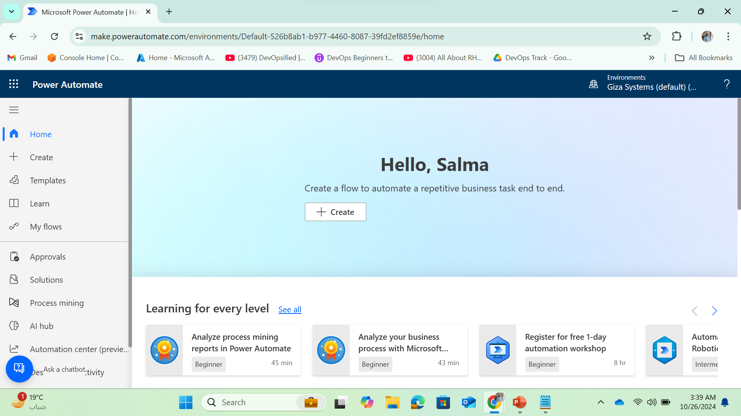


Managing Daily Logs using Elasticsearch and Kibana

Slide 2
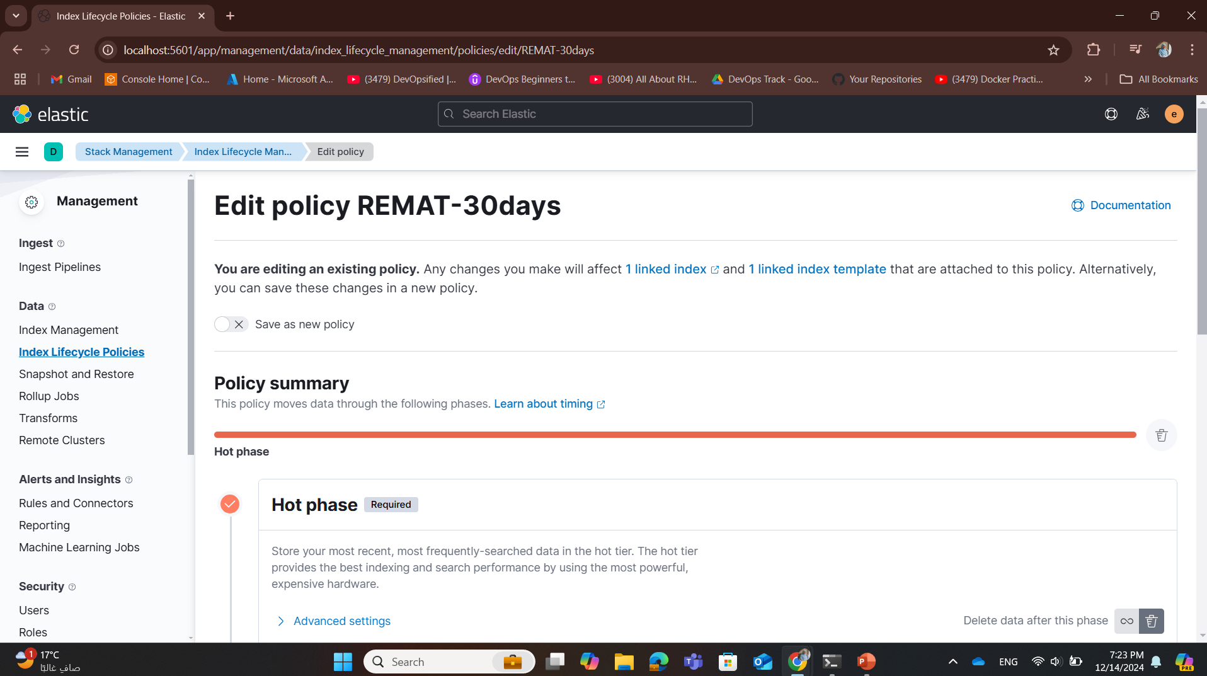
1- Create Index Lifecycle Policy (ILM) named (REMAT-30days)

Slide 3
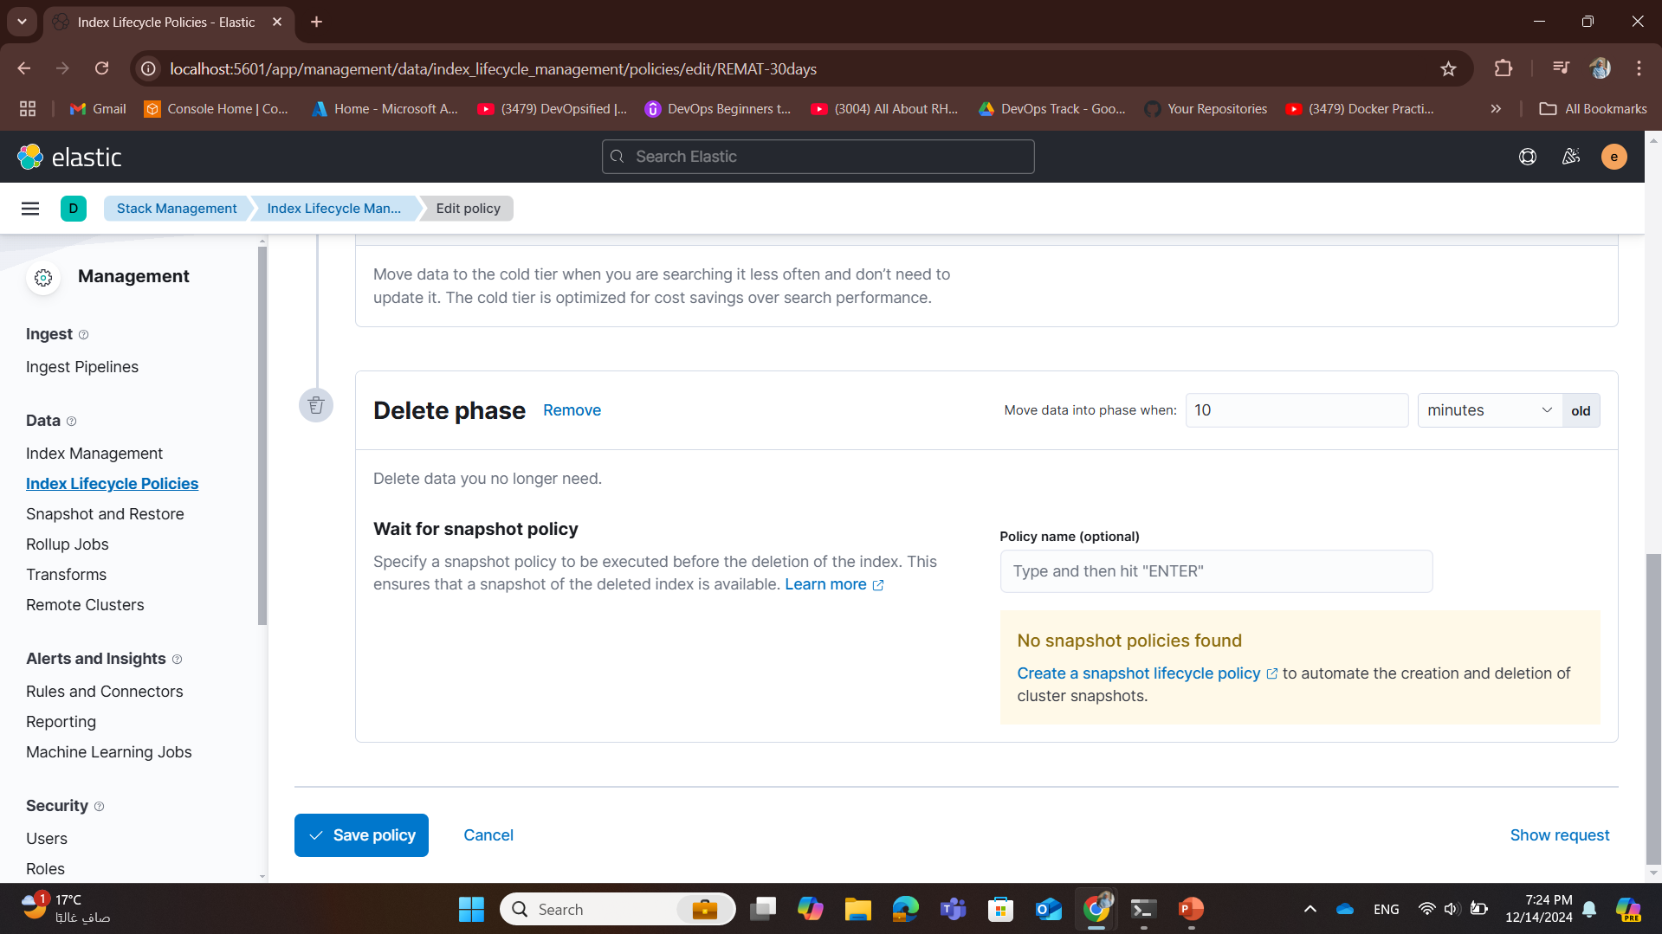
1- After hot phase by 10 mins data will be moved to delete phase

Slide 4
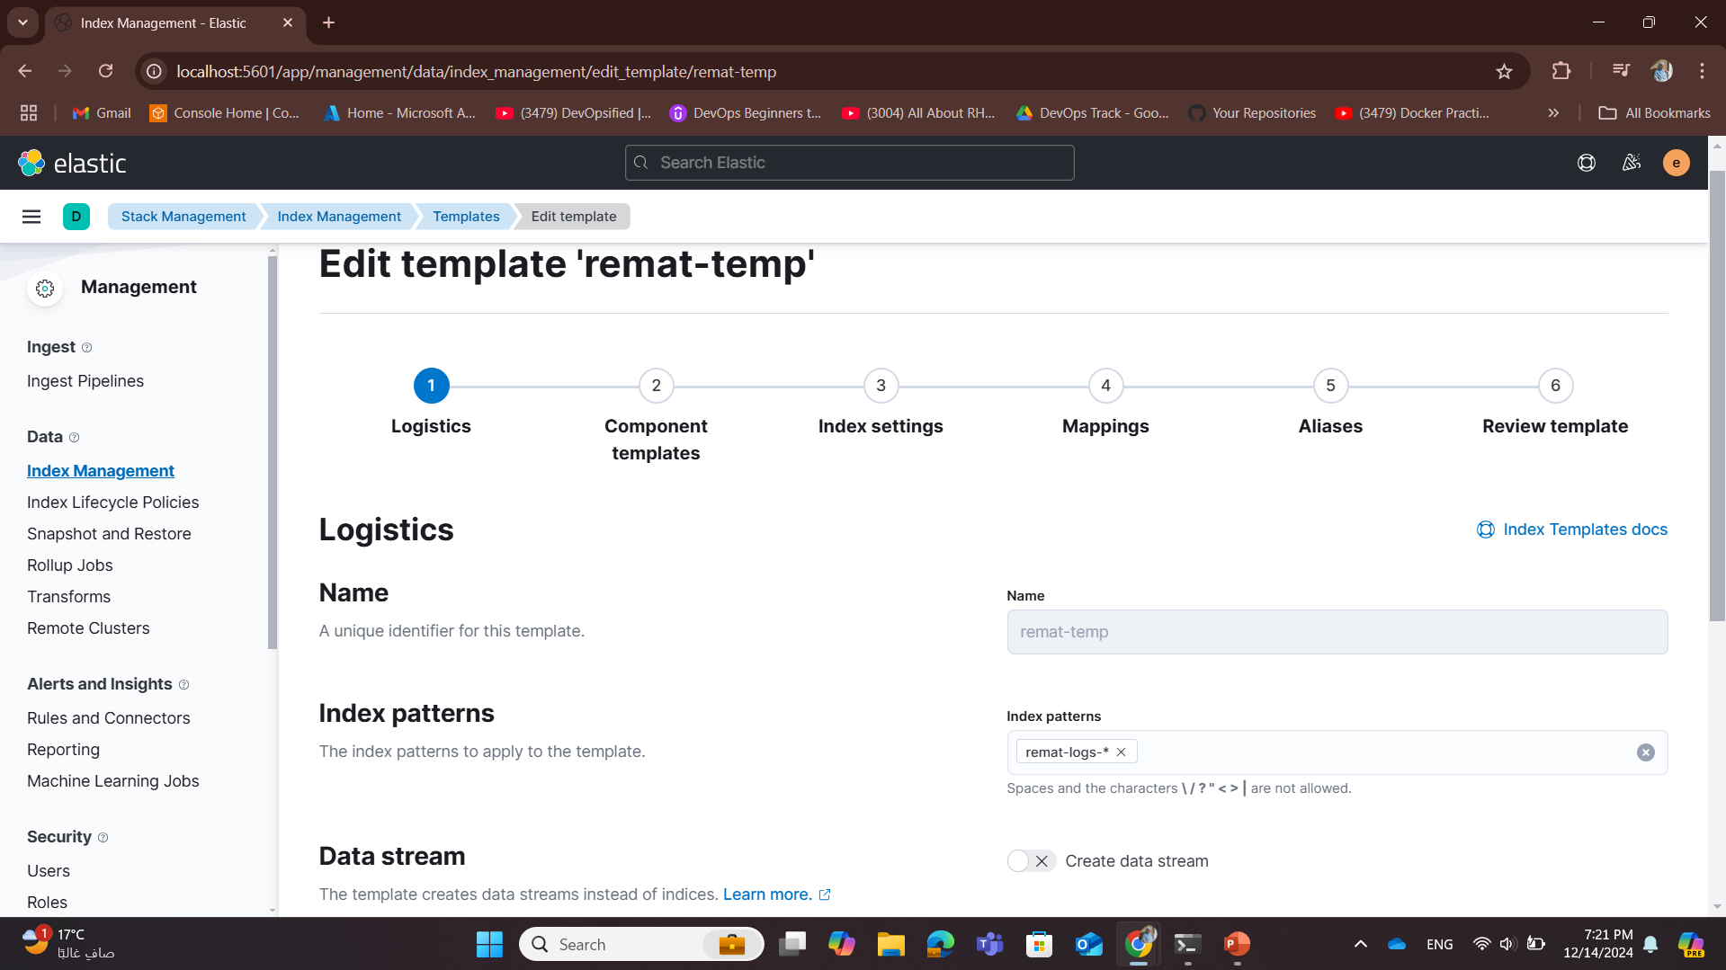
2- Create Index Template with index pattern (remat-logs-*)

Slide 5
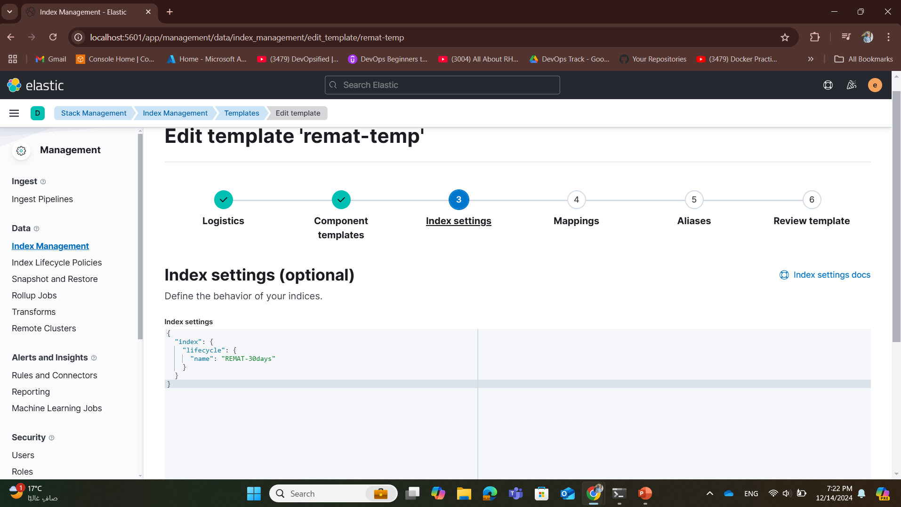
3- In the index template’s setting add the Lyfecycle policy to be attached to the template and implemented on any index with pattern remat-logs-*

Slide 6
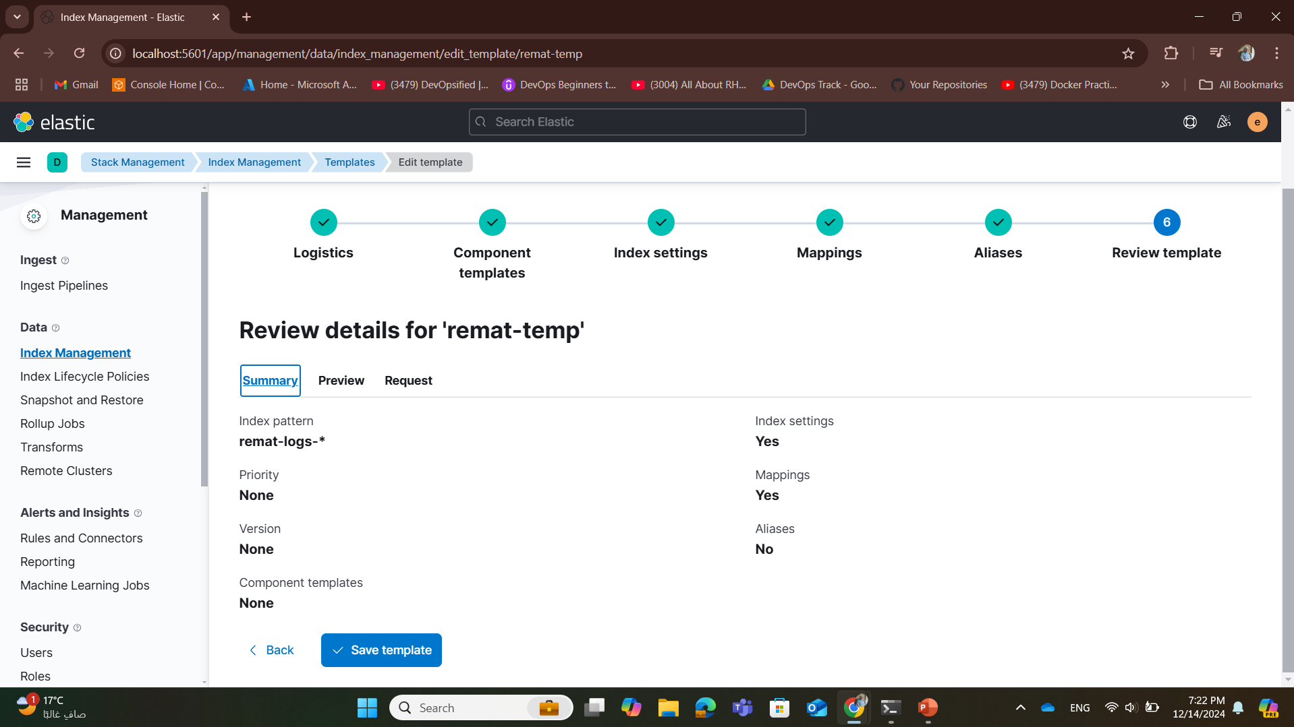
4- The Index Template with index pattern (remat-logs-*) after being created

Slide 7
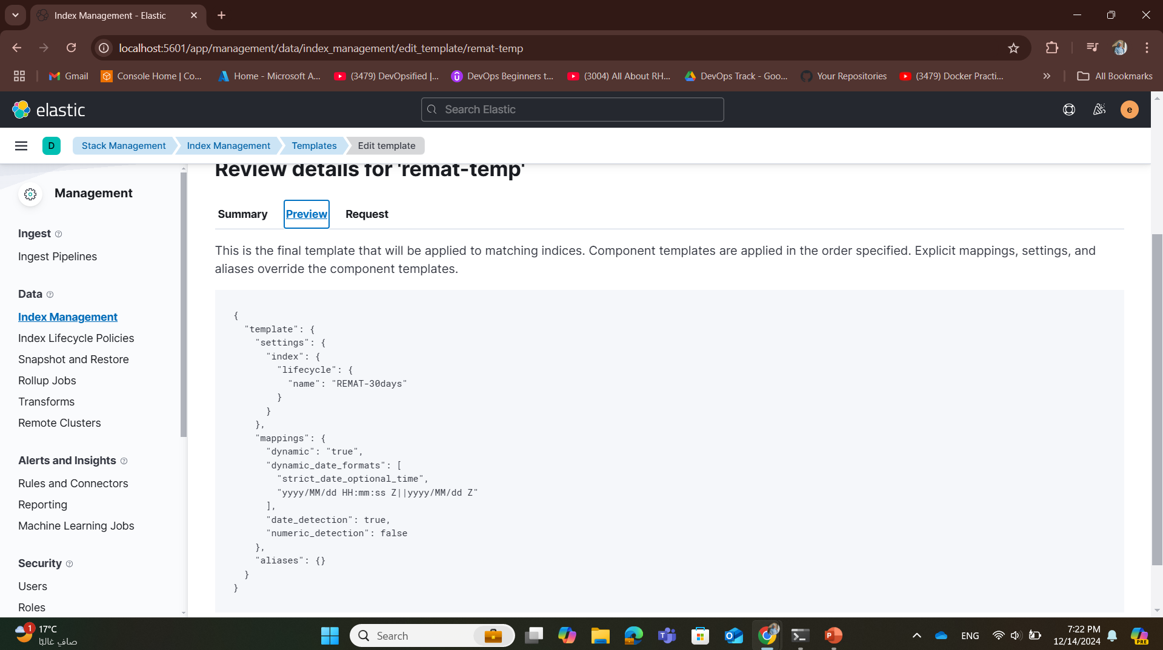
4- The Index Template after being created with lifecycle (REMAT-30days) policy attached

Slide 8
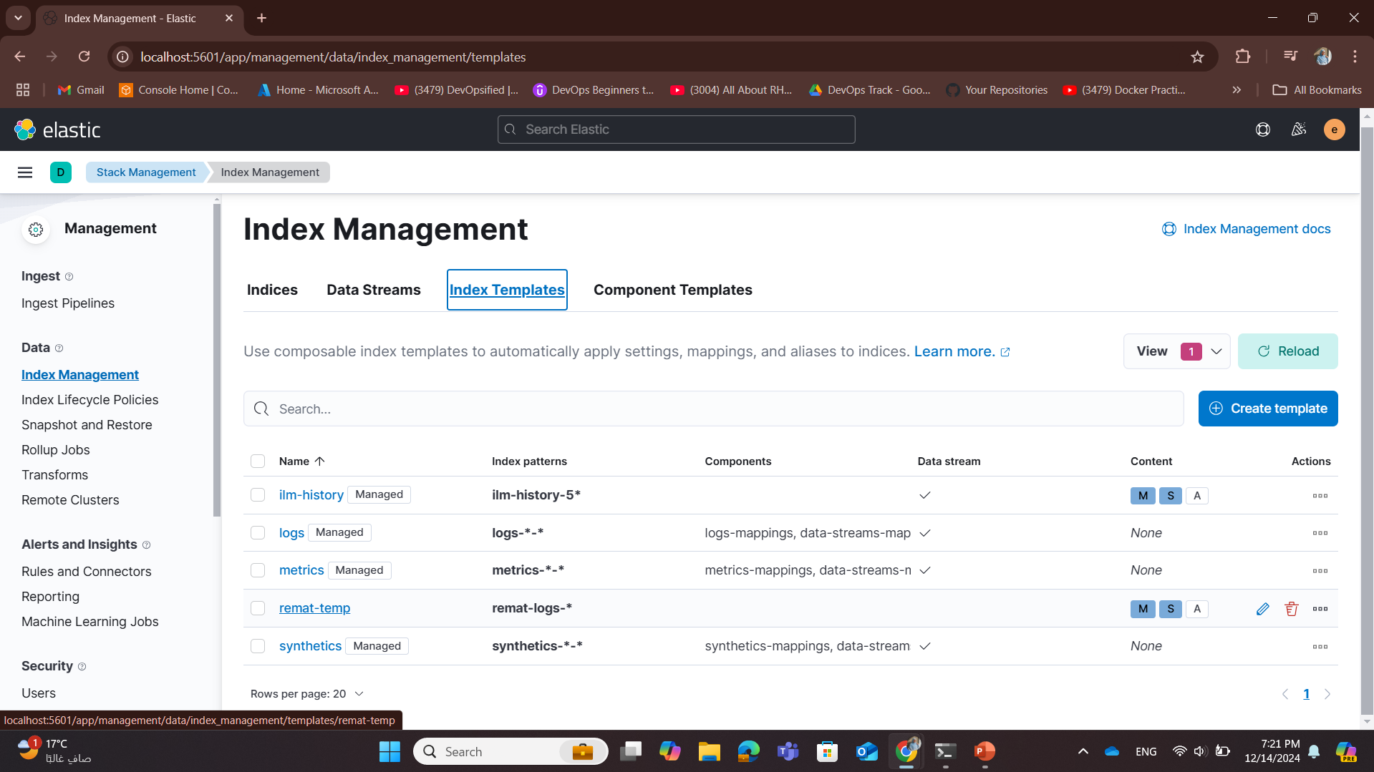
4- The Index Template with index pattern (remat-logs-*) after being created

Slide 9
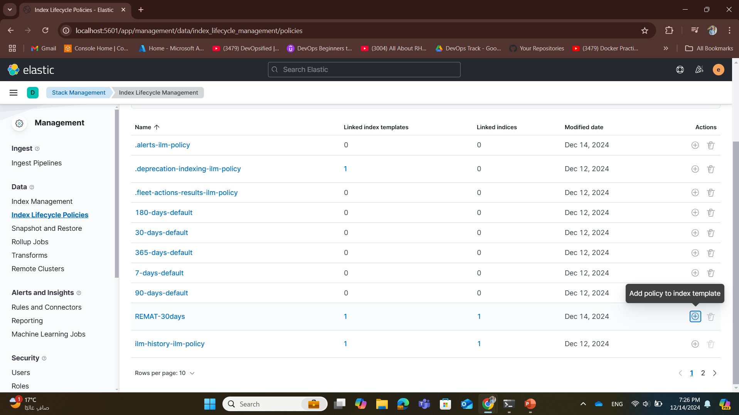
5- Another method to attach the ILM policy to index template

Slide 10
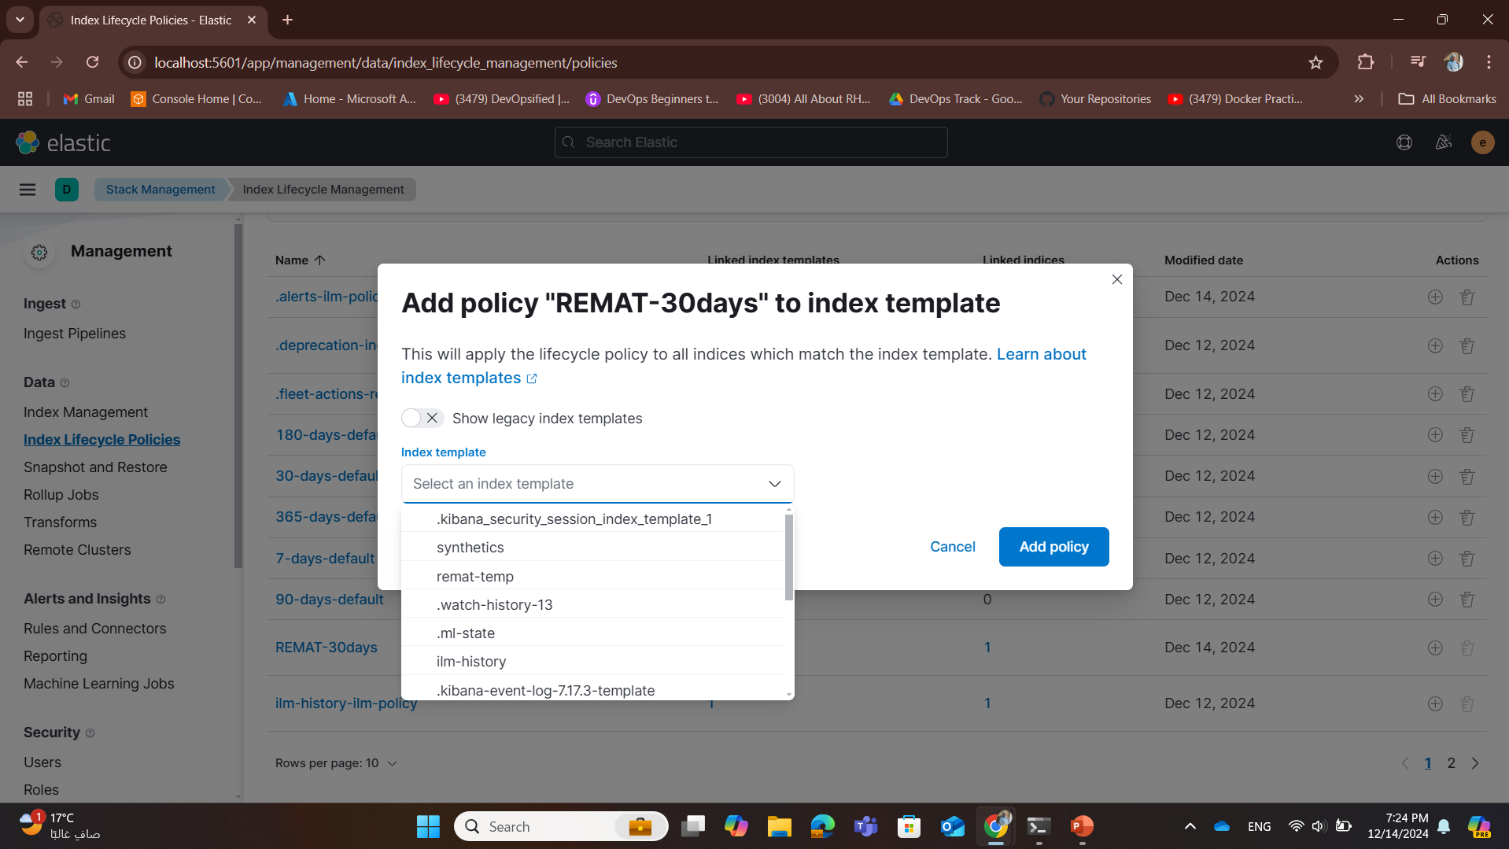
5- Another method to attach the ILM policy to index template

Slide 11
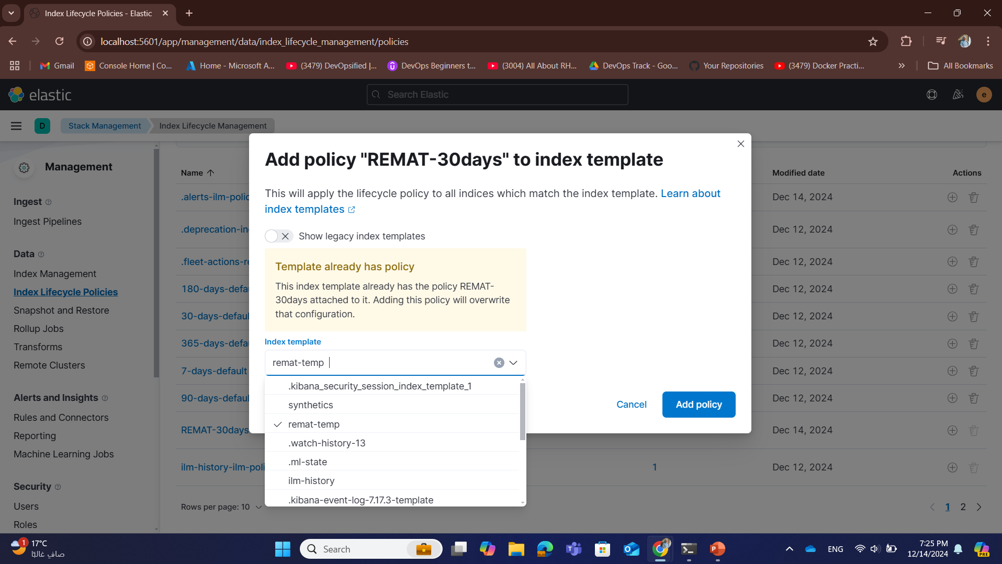
5- Another method to attach the ILM policy to index template

Slide 12
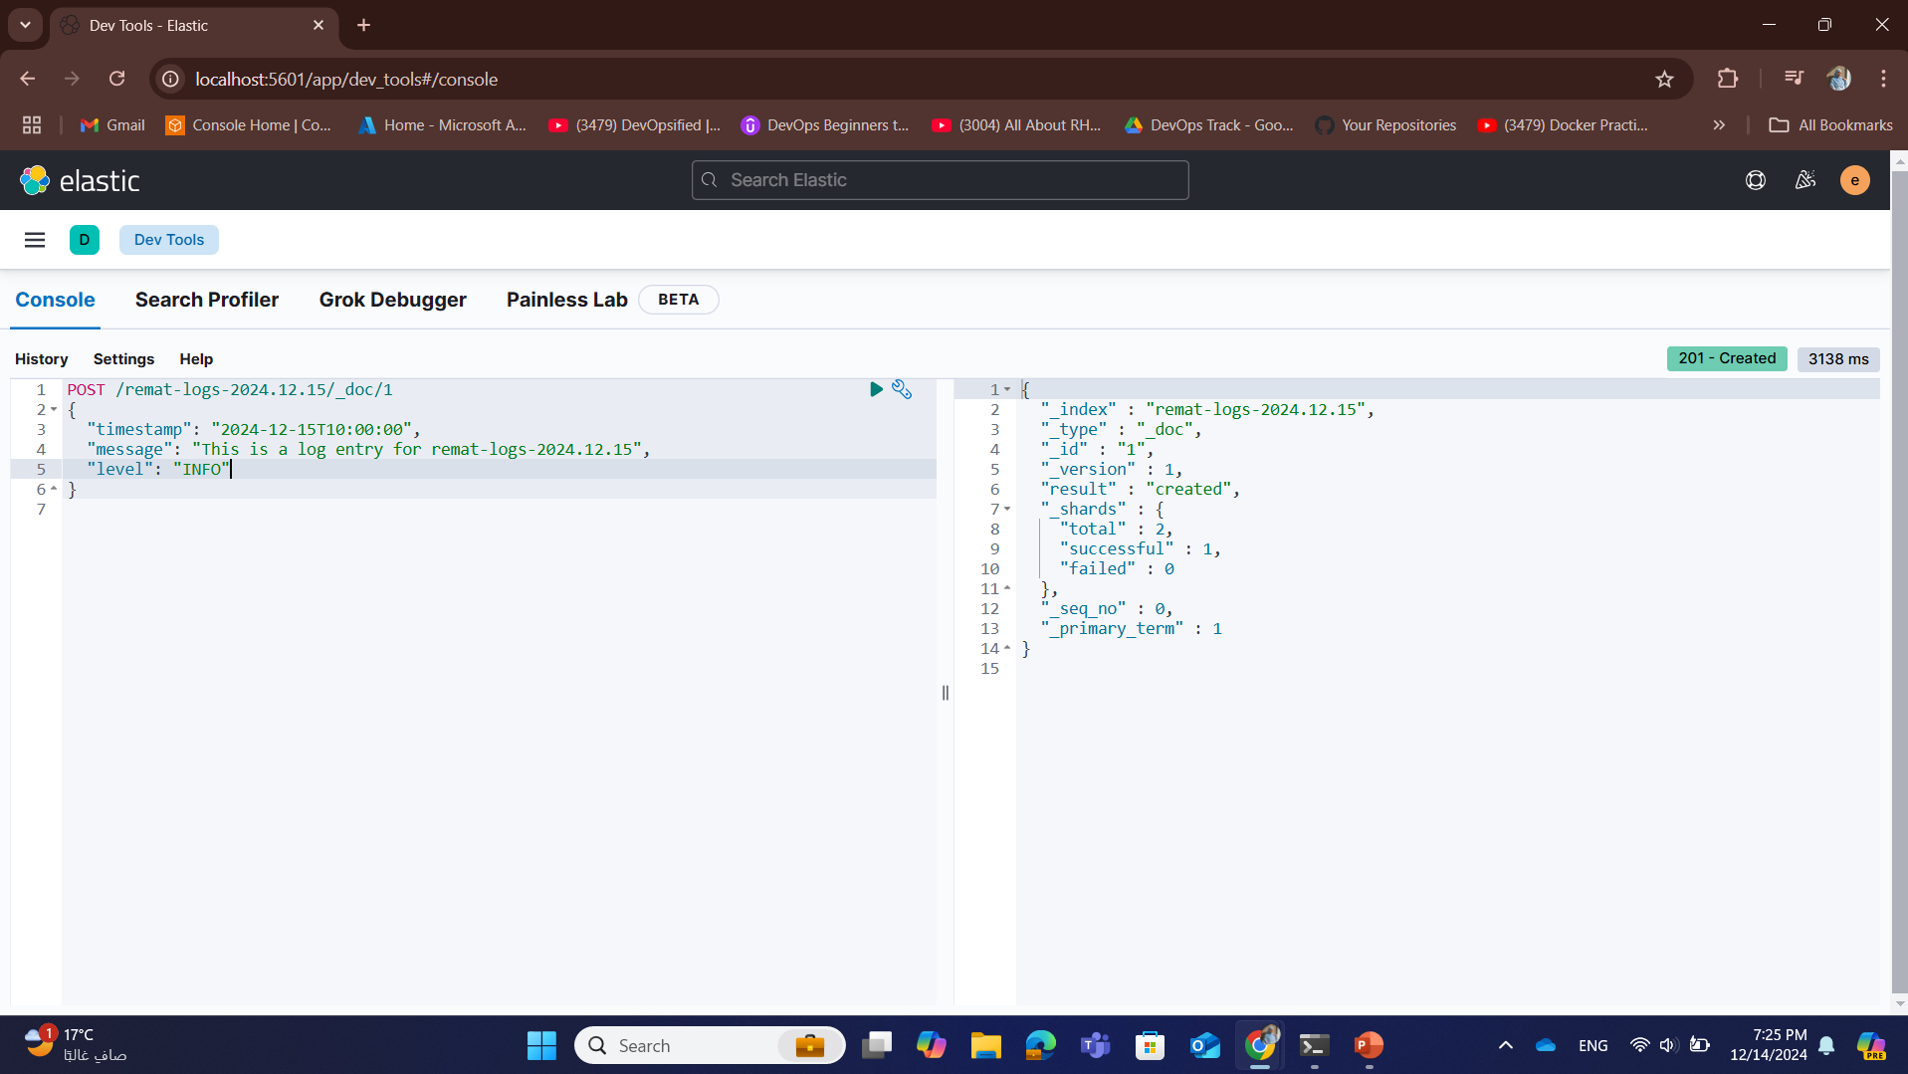
6- Sending data

Slide 13
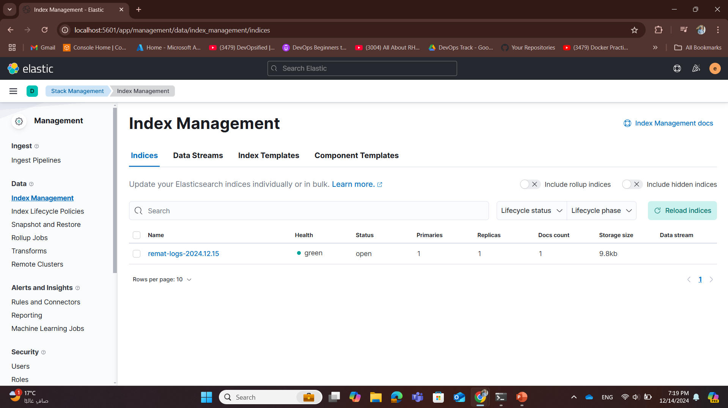
7- index created

Slide 14
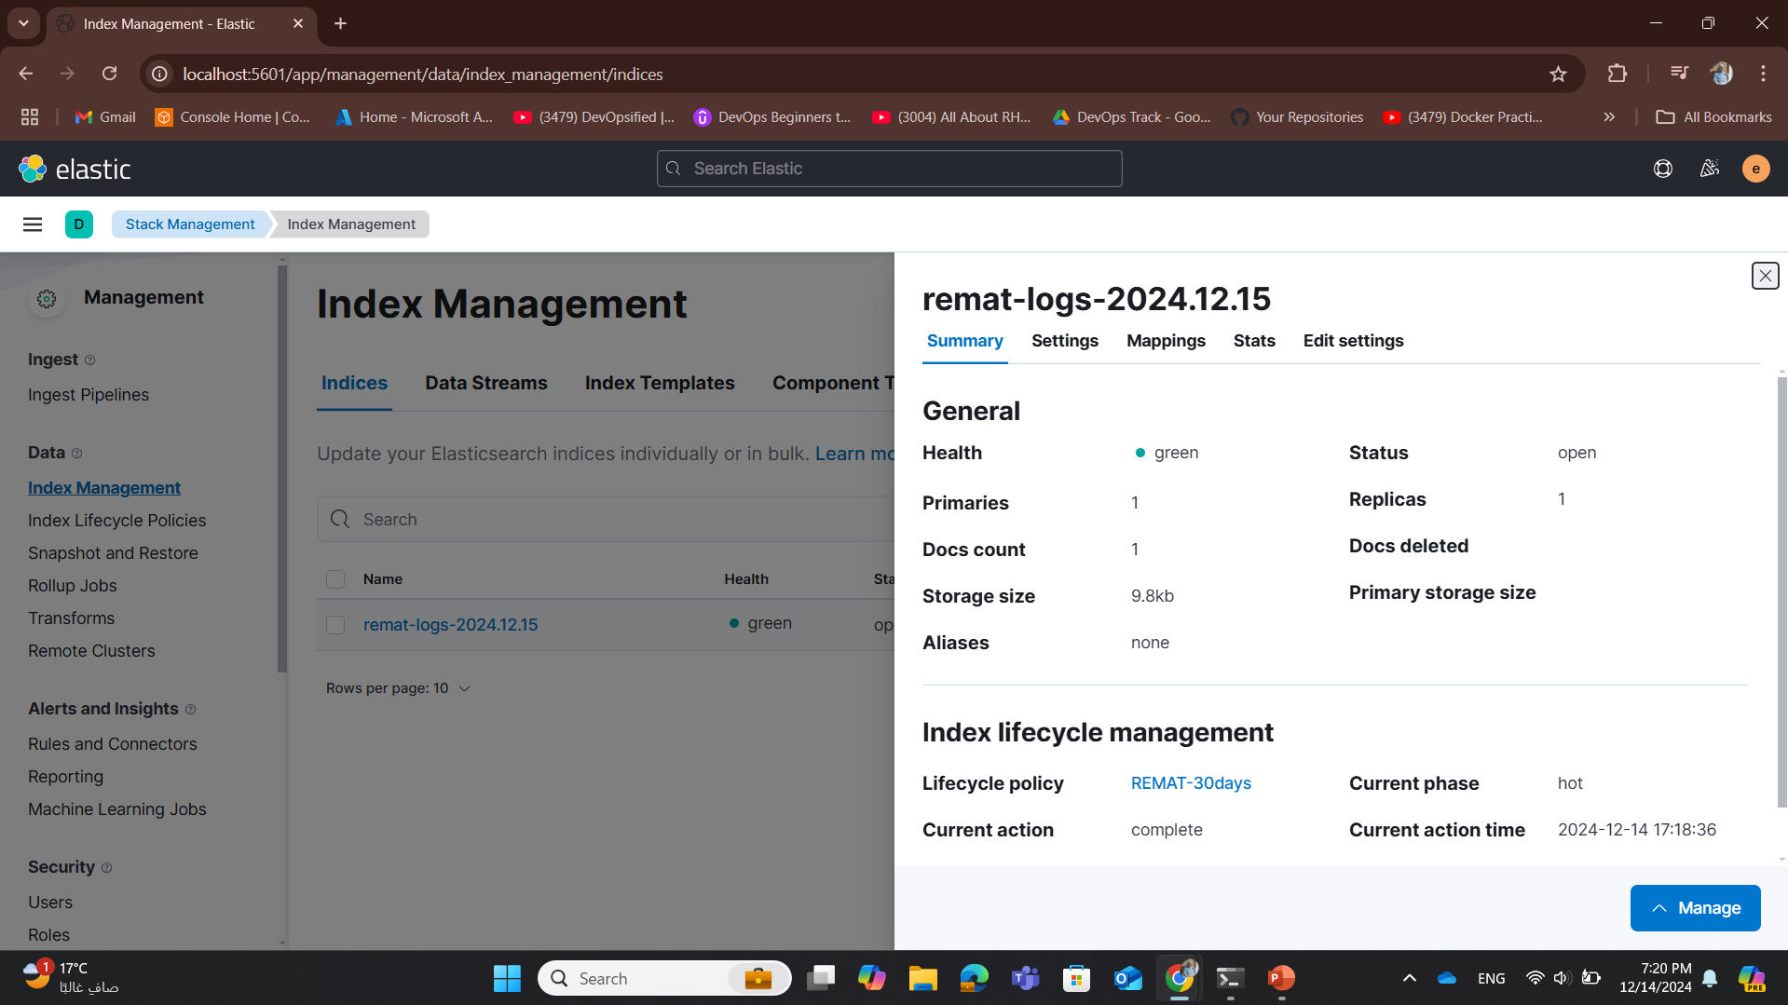
7- index in hot phase

Slide 15
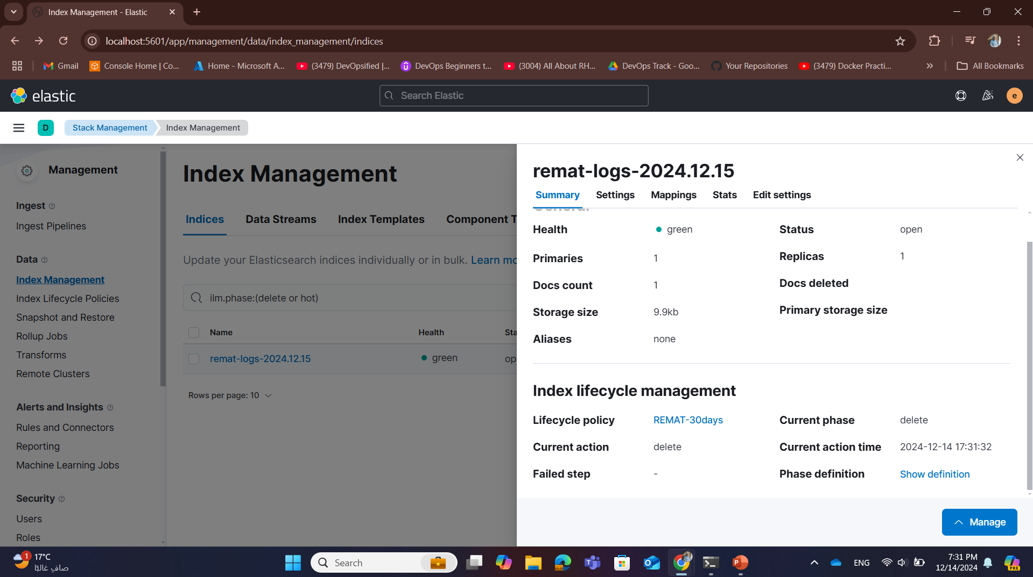
8- index in delete phase after 10 mins

Slide 16
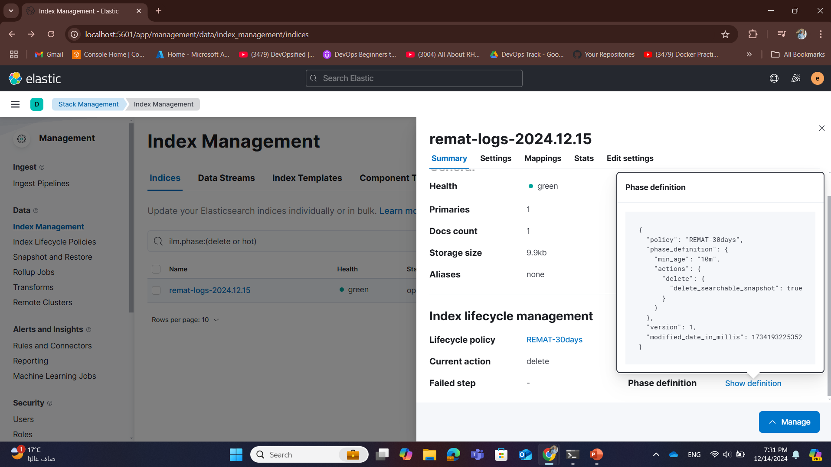
8- index in delete phase after 10 mins

Slide 17
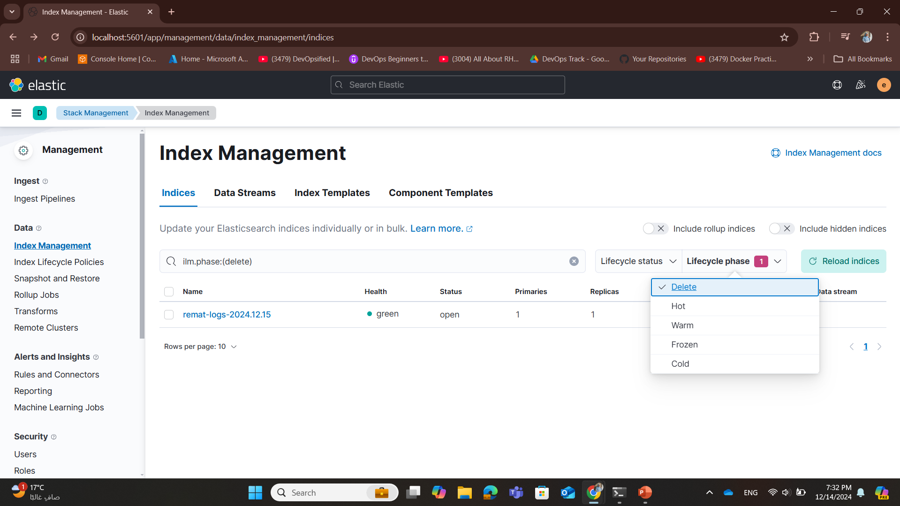
8- index in delete phase after 10 mins

Slide 18
Snapshoots Repositories
Using Cloud Storage (AWS S3, Azure, GCP)
Using Shared Storage (NFS)
Using Local File System

Slide 19
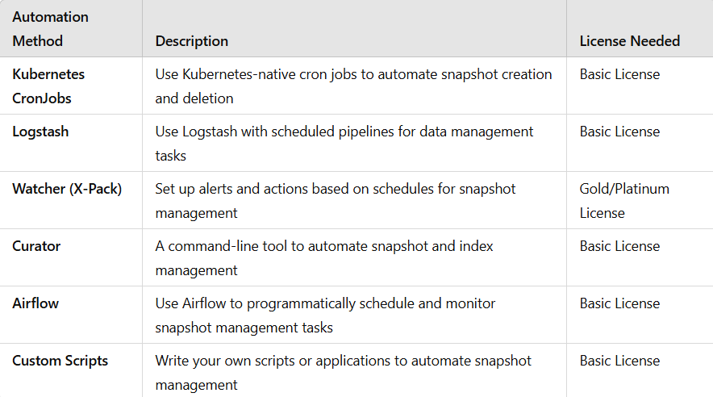
Basic License in Elasticsearch, some advanced features of SLM (like automatic snapshot management) are not available,
Snapshot Lifecycle Management (SLM)
Helps automate the process of creating, managing, and deleting snapshots of data at scheduled intervals
Basic License in Elasticsearch, some advanced features of SLM (like automatic snapshot management) are Not Available

